Slide 1
Mini Project 4 Results
CS5567
Alexander Dowell

Slide 2
Process
After employing transfer learning with the VGG19 CNN to classify images from 70% of the 'archive' dataset, the model achieved a validation accuracy of 92%. The network then utilized the remaining 30% of images per identity to evaluate the cosine similarity between enrollment (33%) and verification (66%) images. This approach enabled the assessment of the model's performance in distinguishing genuine and imposter samples while validating the efficacy of the transfer learning method applied.

Slide 3
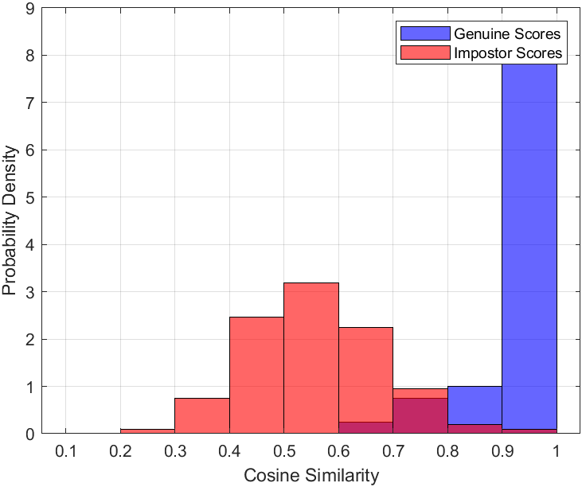
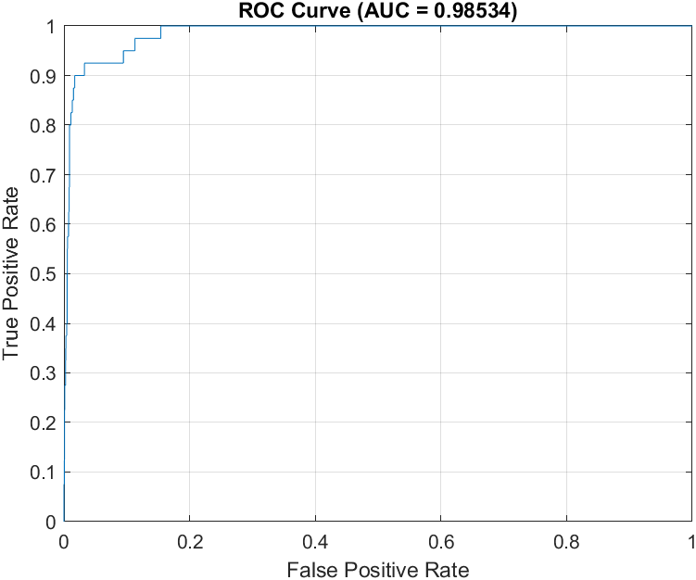
Results

Slide 4
Results Continued
The histogram, ROC, and AUC results align with expectations. The imposter class exhibits a cosine similarity mean ranging from 50% to 60%, while the genuine class's mean lies between 90% and 100%. Regrettably, there is some overlap between the two classes in the range of 60% to 100%. Given that the network achieved a validation accuracy of 92%, this overlap was anticipated. Nevertheless, the overlap is relatively minimal, as demonstrated by the AUC of 98.5%. This indicates that the model performs well in distinguishing genuine and imposter samples, despite the presence of some overlap.

Slide 5
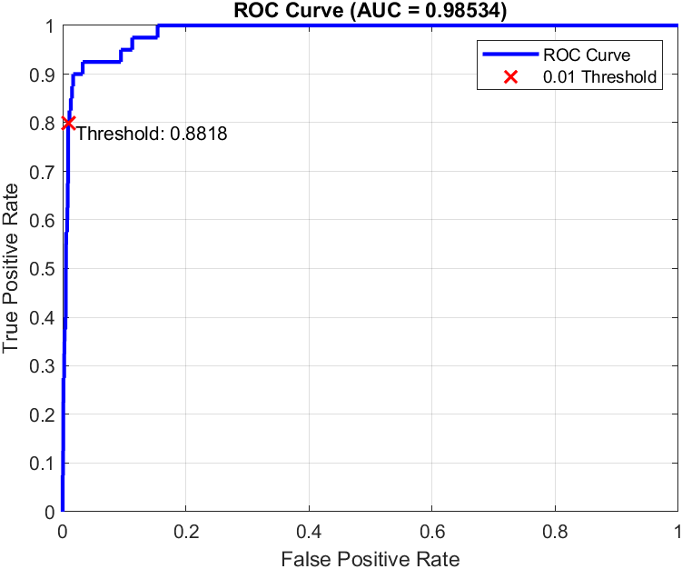
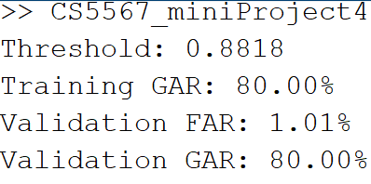
Bonus

Slide 6
Bonus Continued
The results show that the chosen decision threshold is 0.8818, which provides a balance between genuine acceptance and false acceptance rates. The Training Genuine Acceptance Rate (GAR) at this threshold is 80.00%, indicating that the model correctly authenticates 80% of the genuine samples in the training set. The Validation False Acceptance Rate (FAR) is slightly above the desired 1% at 1.01%, which means that approximately 1.01% of impostor samples are falsely accepted as genuine by the model. The Validation GAR is also 80.00%, demonstrating that the model's performance on the validation set is consistent with its performance on the training set. In summary, the model achieves an acceptable balance between security and usability, with a relatively low FAR and a reasonably high GAR. However, there is still room for improvement to minimize the FAR and increase the GAR for a more robust authentication system.

